Slide 1

Black Friday analysis

Slide 2

Introduction
Black Friday is a colloquial term for the Friday after Thanksgiving in the United States. It traditionally marks the start of the Christmas shopping season in the United States. Many stores offer highly promoted sales at discounted prices and often open early, sometimes as early as midnight, or even on Thanksgiving. Some stores’ sales continue until Monday or for a week. Black Friday has routinely been the busiest shopping day of the year in the United States.

Slide 3
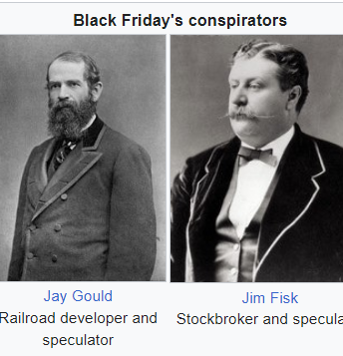
Introduction
The term “Black Friday” has been used for centuries to describe days marked by disastrous events. While there have been many such occurrences, the most significant “Black Friday” in American history took place during the Panic of 1869. This financial crisis was sparked by Jay Gould and James Fisk, who used their connections with the Grant Administration to attempt to monopolize the gold market. Upon learning of the scheme, President Grant ordered the Treasury to release a large amount of gold, which put a stop to the manipulation but also caused prices to plummet by 18%. The fallout from this event was swift and severe, with fortunes being made and lost in a single day.

Slide 4
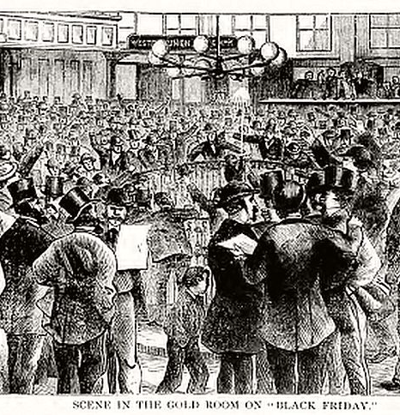
Introduction
The first recorded use of the term “Black Friday” to describe the day after Thanksgiving dates to November 1951 and was published in the journal, Factory Management, and Maintenance. The term was used again in 1952 and referred to the practice of workers calling in sick on that day to extend their holiday weekend to four days.
In Philadelphia and Rochester, the police began using the terms “Black Friday” and “Black Saturday” in the early 1960s to describe the heavy traffic and chaotic crowds that accompanied the start of the Christmas shopping season. Despite efforts by retailers to rebrand the day as “Big Friday” in the 1960s, the term “Black Friday” eventually stuck and became widely used across the United States to describe the day of frenzied shopping that follows Thanksgiving.

Slide 5
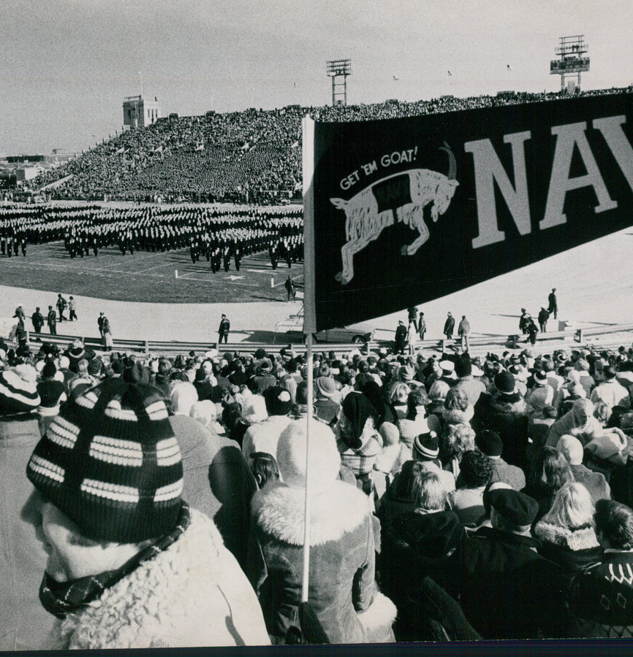
Introduction
Although the term “Black Friday” had been in use for several decades, it was not until November 29, 1975, that it was first mentioned in The New York Times in reference to the busiest shopping and traffic day of the year in Philadelphia. However, the use of the term gradually became more widespread in subsequent years.
Despite its growing popularity, some retailers in other parts of the country remained unaware of the term. In 1981, The Philadelphia Inquirer reported that retailers in Cincinnati and Los Angeles were still unfamiliar with the term “Black Friday” and were instead referring to it as the day after Thanksgiving or the official beginning of the Christmas shopping season. Nevertheless, the term “Black Friday” continued to gain momentum and is now recognized as a common phrase used to describe the day of post-Thanksgiving shopping in the United States.

Slide 6
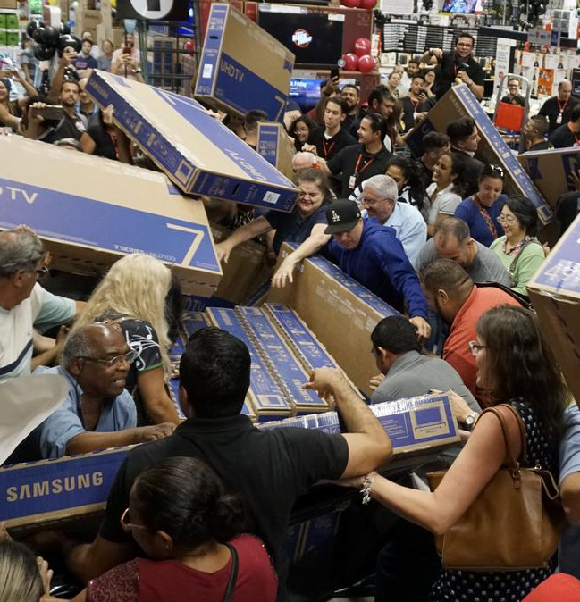
Introduction
In recent times, “Black Friday” has evolved into a massive shopping event featuring a range of sales, promotions, and long queues outside stores. Major retailers like Best Buy, Target, and Amazon have come to rely on Black Friday to drive significant sales and offer door-busting deals to attract shoppers.
The popularity of Black Friday has given rise to other shopping holidays such as “Cyber Monday”, a day dedicated to online shopping, “Small Business Saturday”, which encourages shoppers to support local businesses, and “Giving Tuesday,” a day for charitable giving. These retail holidays have become an integral part of the holiday season, and shoppers eagerly anticipate the deals and discounts they offer. Black Friday, in particular, has become a cultural phenomenon in the United States, with some people camping outside stores for days to be the first in line for deals.

Slide 7

Goal
To understand customer purchase behavior against various products of different categories, we would need to collect and analyze data on customer demographics, purchasing history, and product preferences. So, we will collect data have these characteristics.
Notes:
Here are some of the specific data characteristics that would be useful to collect:
Customer demographics: This includes information such as age, gender, income, education, occupation, and location. Collecting this data can help identify patterns in purchasing behavior across different demographic groups, as well as help develop targeted marketing strategies.
Purchasing history: This includes information on what products customers have purchased in the past, how often they have made purchases, and how much they have spent. Collecting this data can help identify customer preferences and trends in purchasing behavior over time.
Product preferences: This includes information on what types of products customers are interested in, what features they value most, and what factors influence their purchasing decisions. Collecting this data can help identify which products are most popular among different customer segments, as well as help develop new products that meet customer needs.
Transaction data: This includes information on the date, time, and location of each purchase, as well as the payment method used. Collecting this data can help identify patterns in purchasing behavior, such as peak buying times and preferred payment methods.

Slide 8

Problem
For Black Friday, we aim to learn more about the customers through their transactions and purchases.
We want to examine each variable we have and ascertain how it relates to the overall expense of the purchase.
Using descriptive statistics, inference statistics, and hypothesis testing, we aim to learn about customers and their transactions.
Finally, we attempt to group the customers based on the most valuable characteristics and features.
Notes:
Questions we want to answer:
What are the top 10 users based on the number of orders?
What are the top 10 users based on the total purchases?
What are the top 10 items sold on black Friday?
What is the Gender that has the most orders on Black Friday?
What is the Age range that has the most orders on Black Friday?
What is the marital status that has the most orders on black Friday?
What is the city that has the most orders on Black Friday?
What is the occupation that has the most orders on Black Friday?
What is the most common duration of stay in the current city that has the most orders on Black Friday?
Is the mean purchase amount statistically significantly different between the Gender, Age Groups?

Slide 9

Data
Using open data published on Kaggle is a great way to gain insights into consumer behavior during the Black Friday shopping season. Kaggle is a platform that hosts a variety of datasets, including those related to retail sales and consumer behavior.
Notes:
Open data refers to data that is freely available for anyone to access, use, and share without any legal, technical, or financial restrictions. Open data can come from a variety of sources, including governments, non-profit organizations, research institutions, and private companies.

Slide 10

About Data
The dataset provided by “ABC Private Limited” is a valuable resource for understanding customer purchase behavior for various products within different categories. The dataset includes purchase summaries for selected high-volume products, as well as customer demographics, product details, and total purchase amounts from the previous month.
Notes:
Some of the key variables included in the dataset are:
Customer demographics: This includes age, gender, marital status, city type, and other demographic information that can be used to segment customers and identify patterns in their purchasing behavior.
Product details: This includes product ID and product category, which can be used to analyze sales by category and identify popular products.
Purchase amount: This variable provides information on the amount that each customer spent on their purchases, which can be used to identify high-spending customers and analyze purchasing behavior over time.
By analyzing this Black Friday data, a retail company can gain insights into customer behavior and preferences, identify trends and patterns in purchasing behavior, and develop strategies to optimize sales and improve the customer experience.

Slide 11

Data Exploration
In this step we discovered the structure of:
Data
Features
Data types
Missing values
Notes:
Understanding the structure of the data is an important first step in any data analysis or machine learning project.
Data: This refers to the collection of observations or examples that you have available to analyze or model.
The data frame has 550,068 observations (rows) and 12 variables (columns).
Features: These are the variables or attributes that describe each observation in your data.
Here is a brief description of each variable:
User_ID: A unique identifier for each customer.
Product_ID: A unique identifier for each product.
Gender: The gender of the customer.
Age: The age range of the customer.
Occupation: The occupation of the customer.
City_Category: The category of the city where the customer resides.
Stay_In_Current_City_Years: The number of years the customer has lived in their current city.
Marital_Status: The marital status of the customer.
Product_Category_1: The primary category of the product.
Product_Category_2: The secondary category of the product.
Product_Category_3: The tertiary category of the product.
Purchase: The amount spent by the customer on the product.
Data types: Each feature in the dataset will have a data type, which determines how the feature is stored and processed by the analysis or modeling tools. Common data types include numeric (e.g. integers or floating-point numbers), categorical (e.g. strings or boolean values), and datetime (e.g. timestamps or dates).
User_ID, Occupation, Marital_Status, Product_Category_1, Product_Category_2, Product_Category_3, and Purchase are integer variables, Product_ID, Gender, Age, City_Category, and Stay_In_Current_City_Years are character variables. We need to convert most of them to factor type.
Missing values: It's common for real-world datasets to have missing values, which occur when there is no data available for a particular feature in a particular observation. Identifying and handling missing values is an important part of data cleaning and preprocessing, as missing values can cause problems for many analysis and modeling techniques.
This tells us that there are 173,638 missing values in the Product_Category_2 column and 383,247 missing values in the Product_Category_3 column. All the other columns have no missing values.

Slide 12

Data Cleaning
We address the issues we discovered:
Incorrect Datatypes
Impute the missing values with 0 value.
Notes:
In this step, we cleaned our data, changed the column type, and fill in missing values, and errors. We transformed the data into an organized version for analysis.
Missing values:
We want to fill the missing values in the columns: Product_Category_2, and Product_Category_3 with 0. Because this indicates that this product is not included in multiple categories.
Type Casting:
We want to convert all the columns type to Factor type unless the purchase column.

Slide 13

Descriptive Statistics
Here are some insights based on the summary of the Black Friday data:
User ID 1001680 appears the most frequently in the data, with a count of 1026.
Product ID P00265242 appears the most frequently in the data, with a count of 1880.
There are 135809 female users and 414259 male users in the data. This suggests that there are more male users than female users in the data.
Notes:
Descriptive statistics are a set of techniques used to summarize and describe characteristics of a dataset. They provide a way to understand the main features of the data, such as its central tendency, variability, and distribution. Here are some common descriptive statistics:
Central tendency: This describes the typical or central value of the data. The most common measures of central tendency are the mean, median, and mode.
Variability: This describes how spread out or dispersed the data is. Common measures of variability include the range, variance, and standard deviation.
Distribution: This describes the shape of the data. Common distributions include normal, skewed, and bimodal.
Frequency: This describes how often each value appears in the data. A frequency table or histogram is a common way to visualize frequency.
Correlation: This describes the relationship between two variables. Correlation coefficients, such as Pearson's r or Spearman's rho, are common measures of correlation.
Descriptive statistics can be computed for individual variables or for pairs of variables. They are often used to explore the data and identify patterns, outliers, and relationships between variables. Descriptive statistics can also be used to summarize the data in a way that is easy to communicate to others, such as by creating tables, charts, or graphs.

Slide 14
Descriptive Statistics
The most common age group is 26-35, with a count of 219587, while the least common age group is 0-17, with a count of 15102.
The most common occupation is 4, with a count of 72308.
The most common city category is B, with a count of 231173, while the least common city category is A, with a count of 147720.
Most users in the data are single with a count of 324731, while the remaining users are married.
Notes:
Descriptive statistics are a set of techniques used to summarize and describe characteristics of a dataset. They provide a way to understand the main features of the data, such as its central tendency, variability, and distribution. Here are some common descriptive statistics:
Central tendency: This describes the typical or central value of the data. The most common measures of central tendency are the mean, median, and mode.
Variability: This describes how spread out or dispersed the data is. Common measures of variability include the range, variance, and standard deviation.
Distribution: This describes the shape of the data. Common distributions include normal, skewed, and bimodal.
Frequency: This describes how often each value appears in the data. A frequency table or histogram is a common way to visualize frequency.
Correlation: This describes the relationship between two variables. Correlation coefficients, such as Pearson's r or Spearman's rho, are common measures of correlation.
Descriptive statistics can be computed for individual variables or for pairs of variables. They are often used to explore the data and identify patterns, outliers, and relationships between variables. Descriptive statistics can also be used to summarize the data in a way that is easy to communicate to others, such as by creating tables, charts, or graphs.

Slide 15
Descriptive Statistics
The most common duration of stay in the current city is one year, with a count of 193821 users. There are also significant numbers of users who have stayed for two years (101838), three years (95285), four or more years (84726), and by zero years with a count of 74398 users
The average purchase amount is 9264 dollars, while the minimum and maximum purchase amounts are 12 dollars and 23961 dollars , respectively.
Notes:
Descriptive statistics are a set of techniques used to summarize and describe characteristics of a dataset. They provide a way to understand the main features of the data, such as its central tendency, variability, and distribution. Here are some common descriptive statistics:
Central tendency: This describes the typical or central value of the data. The most common measures of central tendency are the mean, median, and mode.
Variability: This describes how spread out or dispersed the data is. Common measures of variability include the range, variance, and standard deviation.
Distribution: This describes the shape of the data. Common distributions include normal, skewed, and bimodal.
Frequency: This describes how often each value appears in the data. A frequency table or histogram is a common way to visualize frequency.
Correlation: This describes the relationship between two variables. Correlation coefficients, such as Pearson's r or Spearman's rho, are common measures of correlation.
Descriptive statistics can be computed for individual variables or for pairs of variables. They are often used to explore the data and identify patterns, outliers, and relationships between variables. Descriptive statistics can also be used to summarize the data in a way that is easy to communicate to others, such as by creating tables, charts, or graphs.

Slide 16
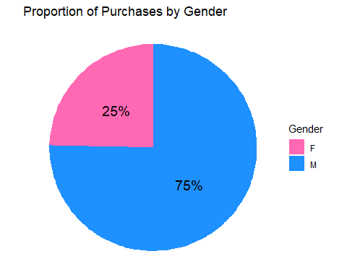
Descriptive Statistics
What is the Gender that has the most orders Gender on Black Friday?
Based on this chart, it appears that males made up most purchases on Black Friday, with 75% of all purchases, while females made up 25% of all purchases.
Notes:
A pie chart is a circular graphical representation of data, where the whole circle represents 100% of the data and is divided into sectors or slices, with each sector representing a proportion or percentage of the total.
Pie charts are commonly used to illustrate the relative proportions of different categories or groups in a dataset. Each category is assigned a slice of the pie, and the size of the slice is proportional to the relative frequency or proportion of the category in the dataset. The slices of the pie are typically labeled with the category name and/or percentage of the total.
Pie charts are useful for showing how a whole is divided into parts and can be used to highlight the most common or important categories in a dataset. However, pie charts can be difficult to interpret accurately, especially when there are many categories or when the differences between the categories are small. It can also be difficult to compare the sizes of the slices in a pie chart, as the angles of the slices can be deceiving to the human eye.

Slide 17
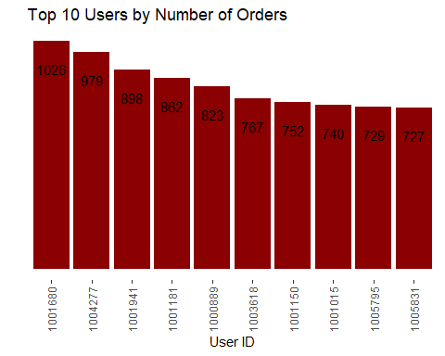
Descriptive Statistics
What are the top 10 users based on the number of orders?
We can see that users 1001680 and user 979 were the most active customers on black Friday.
The range of the orders of the top 10 active customers range from 1026 to 727 order.
Notes:
A bar chart is a graphical representation of data, where bars are used to represent the values or frequencies of a categorical variable. The height or length of each bar is proportional to the value or frequency of the category it represents.
Bar charts are commonly used to compare the values or frequencies of different categories or groups in a dataset. The categories are typically arranged along the x-axis of the chart, while the values or frequencies are plotted on the y-axis. The bars can be either vertical or horizontal, depending on the orientation of the chart.
Bar charts are useful for showing how different categories or groups compare to each other and can be used to highlight the most common or important categories in a dataset. They are often used in conjunction with other visualization techniques, such as pie charts or line charts, to provide a more complete picture of the data.

Slide 18
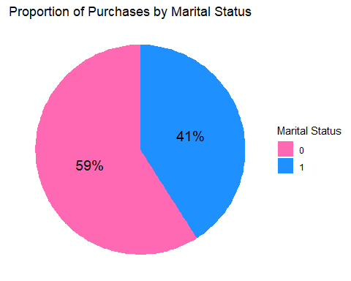
Descriptive Statistics
What is the marital status that has the most orders on black Friday?
There were 59% of purchases made by customers who were single and 41% of purchases made by customers who were married.
Notes:
A pie chart is a circular graphical representation of data, where the whole circle represents 100% of the data and is divided into sectors or slices, with each sector representing a proportion or percentage of the total.
Pie charts are commonly used to illustrate the relative proportions of different categories or groups in a dataset. Each category is assigned a slice of the pie, and the size of the slice is proportional to the relative frequency or proportion of the category in the dataset. The slices of the pie are typically labeled with the category name and/or percentage of the total.
Pie charts are useful for showing how a whole is divided into parts and can be used to highlight the most common or important categories in a dataset. However, pie charts can be difficult to interpret accurately, especially when there are many categories or when the differences between the categories are small. It can also be difficult to compare the sizes of the slices in a pie chart, as the angles of the slices can be deceiving to the human eye.

Slide 19
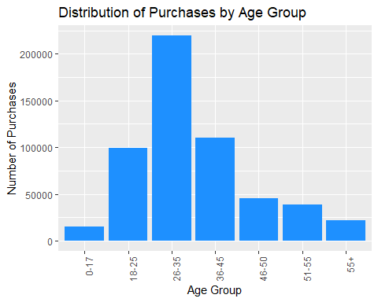
Descriptive Statistics
What is the Age range that has the most orders on Black Friday?
It looks like there were 219,587 purchases made by the age group of 26-35, followed by 110,013 purchases made by the age group of 36-45, and 99,660 purchases made by the age group of 18-25.
Notes:
This is a histogram plot. A histogram is a graphical representation of the distribution of a continuous variable. It shows the frequency of occurrence of different values or ranges of values in a dataset.
To create a histogram, the range of values for the variable of interest is divided into a set of equally sized intervals or bins. The frequency of observations falling into each bin is then plotted on the vertical axis, while the ranges of values for each bin are plotted on the horizontal axis. Typically, the bars of a histogram are adjacent and have no gaps between them, as the bins are continuous intervals.
Histograms are useful for visualizing the shape of a distribution, as well as for identifying patterns, outliers, and skewness. For example, a normal distribution will have a bell-shaped histogram, while a skewed distribution will have a histogram that is skewed to one side. Histograms can also be used to identify gaps or clusters in the data and to determine whether the data is symmetrical or skewed.

Slide 20
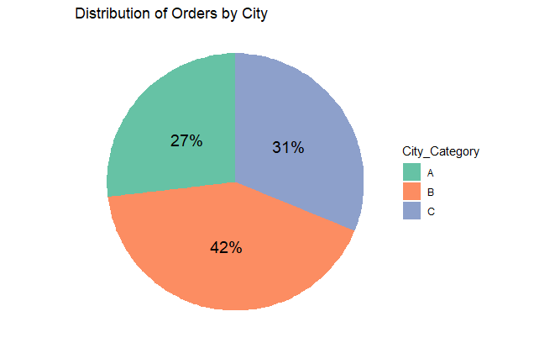
Descriptive Statistics
What is the city that has the most orders on Black Friday?
It looks like there were 42% of the orders made in cities categorized as "B", 31% of orders made in cities categorized as "C", and 27% of the orders made in cities categorized as "A".
The city category with the most orders in the Black Friday is category "B".
Notes:
A pie chart is a circular graphical representation of data, where the whole circle represents 100% of the data and is divided into sectors or slices, with each sector representing a proportion or percentage of the total.
Pie charts are commonly used to illustrate the relative proportions of different categories or groups in a dataset. Each category is assigned a slice of the pie, and the size of the slice is proportional to the relative frequency or proportion of the category in the dataset. The slices of the pie are typically labeled with the category name and/or percentage of the total.
Pie charts are useful for showing how a whole is divided into parts and can be used to highlight the most common or important categories in a dataset. However, pie charts can be difficult to interpret accurately, especially when there are many categories or when the differences between the categories are small. It can also be difficult to compare the sizes of the slices in a pie chart, as the angles of the slices can be deceiving to the human eye.

Slide 21
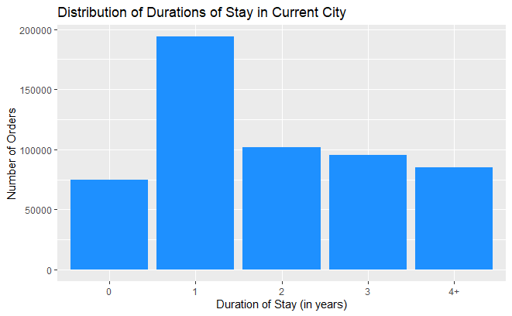
Descriptive Statistics
What is the most common duration of stay in the city that has the most orders on Black Friday?
The most common duration of stay in the current city is "1 year", with 193,821 orders. The other duration of stay in descending order based on the number of orders are:
"2 years": 101,838 orders
"3 years": 95,285 orders
"4+ years": 84,726 orders
"0 years": 74,398 orders
Notes:
This is a histogram plot. A histogram is a graphical representation of the distribution of a continuous variable. It shows the frequency of occurrence of different values or ranges of values in a dataset.
To create a histogram, the range of values for the variable of interest is divided into a set of equally sized intervals or bins. The frequency of observations falling into each bin is then plotted on the vertical axis, while the ranges of values for each bin are plotted on the horizontal axis. Typically, the bars of a histogram are adjacent and have no gaps between them, as the bins are continuous intervals.
Histograms are useful for visualizing the shape of a distribution, as well as for identifying patterns, outliers, and skewness. For example, a normal distribution will have a bell-shaped histogram, while a skewed distribution will have a histogram that is skewed to one side. Histograms can also be used to identify gaps or clusters in the data and to determine whether the data is symmetrical or skewed.

Slide 22
Hypothesis test
Is the mean purchase amount statistically significantly different between the Gender Groups?
We can use a two-sample t-test to test this hypothesis, where we compare the mean purchase amount between the male and female groups.
Null hypothesis (H0): The mean purchase amount is the same between gender groups.
Alternative hypothesis (HA): The mean purchase amount is different between gender groups.
The t-value is -46.358 and the degrees of freedom is 245163, which indicates that there is a significant difference between the mean purchase amount of the male and female groups.
The p-value is less than 2.2e-16, which is much smaller than the significance level of 0.05. Therefore, we can reject the null hypothesis and conclude that the mean purchase amount is significantly different between the male and female groups.
Notes:
A t-test is a statistical test used to determine whether there is a significant difference between the means of two groups of data. It is commonly used to test a hypothesis about the difference between the means of two populations or groups.
There are two types of t-tests:
Independent samples t-test: This is used when the two groups being compared are independent of each other, meaning that the observations in one group are not related to the observations in the other group. For example, you might use an independent samples t-test to compare the mean test scores of students who received a new teaching method to those who received the old teaching method.
Paired samples t-test: This is used when the two groups being compared are related to each other, meaning that each observation in one group is related to a specific observation in the other group. For example, you might use a paired samples t-test to compare the mean weight of a group of people before and after they went on a diet.
The t-test calculates a t-value, which measures the difference between the means of the two groups relative to the variance within each group. The t-value is then compared to a critical value from the t-distribution, which depends on the sample size and the level of significance chosen by the researcher. If the t-value is greater than the critical value, then the difference between the means is considered statistically significant, and the null hypothesis (i.e., that there is no difference between the means) is rejected. If the t-value is not greater than the critical value, then the difference is not considered statistically significant, and the null hypothesis cannot be rejected.
The t-test calculates a t-value, which measures the difference between the means of the two groups relative to the variance within each group. The t-value is then compared to a critical value from the t-distribution, which depends on the sample size and the level of significance chosen by the researcher. If the t-value is greater than the critical value, then the difference between the means is considered statistically significant, and the null hypothesis (i.e., that there is no difference between the means) is rejected. If the t-value is not greater than the critical value, then the difference is not considered statistically significant, and the null hypothesis cannot be rejected.
To conduct a t-test, you need to have the following information:
The means and standard deviations of the two groups being compared.
The sample sizes of the two groups.
The level of significance, which is typically set at 0.05 or 0.01.
Once you have this information, you can use a R or a t-table to calculate the t-value and compare it to the critical value.
It's important to note that the t-test assumes that the data is normally distributed and that the variances of the two groups being compared are equal. If these assumptions are not met, then a different test, such as the Wilcoxon rank-sum test or the Welch's t-test, may be more appropriate.

Slide 23
Hypothesis test
Is the mean purchase amount statistically significantly different between the Age Groups?
We can use an analysis of variance (ANOVA) test to compare the mean purchase amount between the different age groups.
Null hypothesis (H0): The mean purchase amount is the same between age groups.
Alternative hypothesis (HA): The mean purchase amount is different between age groups.
The F-statistic is 40.58, which indicates that there is a significant difference in the mean purchase amount between the age groups.
The p-value is less than 2e-16, which is much smaller than the significance level of 0.05. Therefore, we can reject the null hypothesis and conclude that the mean purchase amount is significantly different between the age groups.
Notes:
ANOVA (Analysis of Variance) is a statistical test used to compare the means of more than two groups of data. It is commonly used to test a hypothesis about the differences between the means of several populations or groups.
There are several types of ANOVA, including one-way ANOVA, two-way ANOVA, and repeated measures ANOVA. The most common type is one-way ANOVA, which is used when there is only one independent variable (such as a categorical variable with three or more levels) and one dependent variable.
The basic idea behind ANOVA is to compare the amount of variation between the groups (also known as the "between-group variation") to the amount of variation within the groups (also known as the "within-group variation"). If the between-group variation is large relative to the within-group variation, then it suggests that there is a significant difference between the means of the groups.
The ANOVA test calculates an F-value, which is the ratio of the between-group variation to the within-group variation. The F-value is then compared to a critical value from the F-distribution, which depends on the sample sizes and the level of significance chosen by the researcher. If the F-value is greater than the critical value, then the difference between the means is considered statistically significant, and the null hypothesis (i.e., that there is no difference between the means) is rejected. If the F-value is not greater than the critical value, then the difference is not considered statistically significant, and the null hypothesis cannot be rejected.
To conduct an ANOVA, you need to have the following information:
The means and standard deviations of each group being compared.
The sample sizes of each group.
The level of significance, which is typically set at 0.05 or 0.01.
Once you have this information, you can use a R or ANOVA table to calculate the F-value and compare it to the critical value.
It's important to note that ANOVA assumes that the data is normally distributed and that the variances of the groups being compared are equal. If these assumptions are not met, then a different test, such as the Kruskal-Wallis test or the Welch's ANOVA, may be more appropriate. Additionally, ANOVA does not tell you which specific groups are different from each other, only that there is a significant difference somewhere. Post-hoc tests, such as Tukey's HSD or Bonferroni's correction, can be used to determine which specific groups differ from each other.

Slide 24
Discussion
From all these analysis we conclude that:
All the features can be used to segment the customers, but the Age group and the Gender are more important.
All the features are very impotent and have more informative insights:
The Gender group is very informative features. (Male is more effective than the female).
The Age Group is important (26-35) group is more active than others.
The city B is more effective than city A and city C.
The occupation factor doesn’t affect more in the purchase value.
The Single customers are very active than the married customers.
The one-year duration in the city factor is more effective than other duration.
We answered all the question we want to discover and test the Gender and Age group statistically.
We suggests that we need further analysis for building linear regression model. We need more ANOVA test, T-test, and Correlation analysis.
Notes:
Regression analysis and correlation analysis are two statistical techniques used to analyze the relationship between two variables.
Correlation analysis is a statistical technique used to measure the strength and direction of the relationship between two quantitative variables. Correlation analysis produces a correlation coefficient, which ranges from -1 to +1. A correlation coefficient of +1 indicates a perfect positive correlation, where the two variables move in the same direction with equal magnitude. A correlation coefficient of -1 indicates a perfect negative correlation, where the two variables move in opposite directions with equal magnitude. A correlation coefficient of 0 indicates no correlation between the two variables. Correlation analysis can be used to explore the relationship between two variables, identify outliers, and assess the strength of a relationship.
Regression analysis is a statistical technique used to model the relationship between a dependent variable and one or more independent variables. The goal of regression analysis is to develop a mathematical equation that can be used to predict the value of the dependent variable based on the values of the independent variables. There are several types of regression analysis, including linear regression, logistic regression, and polynomial regression. Linear regression is the most common type of regression analysis and is used when the relationship between the dependent variable and the independent variable(s) is linear. Regression analysis can be used to explore the relationship between variables, make predictions, and identify important predictors of the dependent variable.

Slide 25

References
Data Source: https://www.kaggle.com/datasets/rajeshrampure/black-friday-sale
https://en.wikipedia.org/wiki/Black_Friday_(shopping)
https://en.wikipedia.org/wiki/Black_Friday_%281869%29
https://www.tibco.com/reference-center/what-is-analysis-of-variance-anova#:~:text=Analysis%20of%20Variance%20(ANOVA)%20is,the%20means%20of%20different%20groups.
https://www.scribbr.com/statistics/t-test/#:~:text=A%20t%20test%20is%20a,are%20different%20from%20one%20another.

